Slide 1

Cryptography
CS-486
September 25th, 2017 r03 Paul A. Lambert

Slide 2
Cryptography
Monday September 25th, 2017
Cracking Passwords
  Homework questions/discussion
  Password strengthening (PBKDF2, Argon2)
Contemporary AEADs
  CBC and Padding Flaws
  ChaCha and Poly (RFC 7539)
  AES-CBC HMAC SHA draft-mcgrew-aead-aes-cbc-hmac-sha2-05)
  AES-SIV (RFC 5297)
  Caesar Competition
Very Big Numbers
Bitcoin and Hashing

Slide 3
Cracking Passwords
Write a Python program to crack passwords.
Requirements:
The program should operate on one or more lines from a Debian Linux ‘shadow’ password file.
For validation of operation of your program, a single line of a shadow file will be provided with a three character password to crack.
Documentation:
Test the program and determine how many passwords are tried per second.
For an 8-character password with lower case, upper case, numbers and 5 special characters – how long would it take your program to determine the password by brute force guessing of each possible password?
Hints:
The Python ‘crypt’ package is directly available and works correctly on Linux platforms. The ‘crypt’ package is available on a Mac, but does not give the correct answer. Other third-party libraries are available that you may try to use, but Linux will be easier.
Read the first chapter of: Violent Python A Cookbook for Hackers, Forensic Analysts, Penetration Testers and Security Engineers (Links to an external site.)Links to an external site.
Pay special attention to pages 20 to 24.
https://eikonal.wordpress.com/category/it/infosec/security-hardening/
https://www.akkadia.org/drepper/SHA-crypt.txt
https://wiki.skullsecurity.org/Passwords
http://web.cs.du.edu/~mitchell/forensics/information/pass_crack.html
http://www.wirelesshack.org/wpa-wpa2-word-list-dictionaries.html
https://www.giac.org/paper/gsec/42/password-cracking-focused-dictionaries/100346
https://spqr.eecs.umich.edu/courses/cs660sp11/papers/10.1.1.128.1635.pdf
http://www.cs.cornell.edu/~shmat/courses/cs6431/passwords.pdf
http://www.cs.cornell.edu/~shmat/courses/cs6431/
https://www.sans.org/reading-room/whitepapers/testing/cracking-active-directory-passwords-how-cook-ad-crack-37940

Slide 4
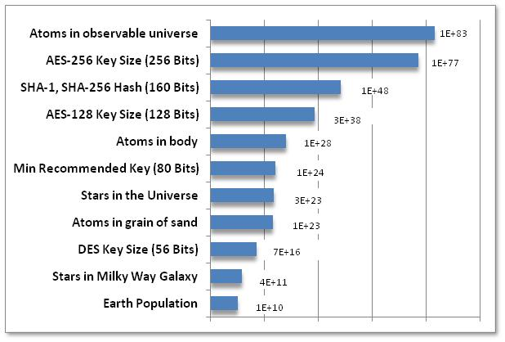
Very Big Numbers
“Astronomy has long been humanity's go-to subject when it comes to contemplating the truly enormous. But actually, if 2¹²⁸ is so much more vast than the number of stars in the observable universe (10¹⁵ times more vast*, or 4,000,000,000,000,000 in long-hand notation), then even the name "astronomical" is rather inadequate.”
  -- from Economist
  http://www.economist.com/blogs/johnson/2011/01/big_numbers

Slide 5
Bitcoin
References:
Bitcoin: A Peer-to-Peer Electronic Cash System
Bitcoin and Cryptocurrency Technologies
  http://bitcoinbook.cs.princeton.edu
  http://www.the-blockchain.com/docs/Princeton%20Bitcoin%20and%20Cryptocurrency%20Technologies%20Course.pdf
Mastering Bitcoin

Slide 6
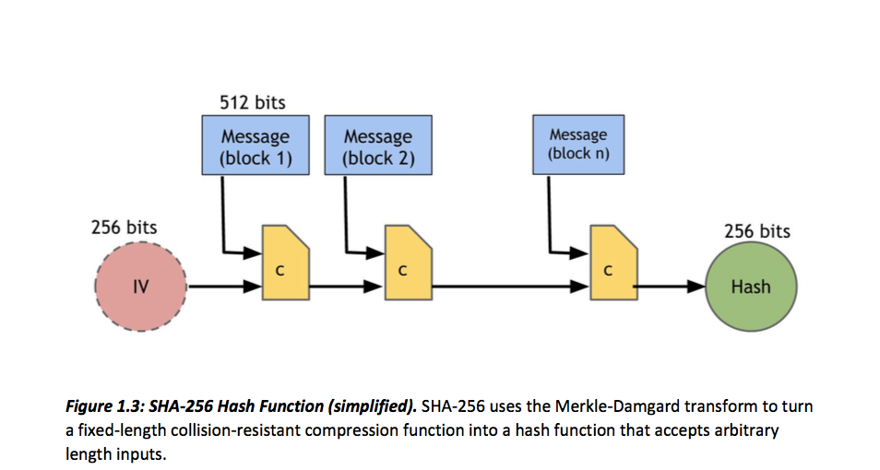
SHA-256
< http://bitcoinbook.cs.princeton.edu >

Slide 7
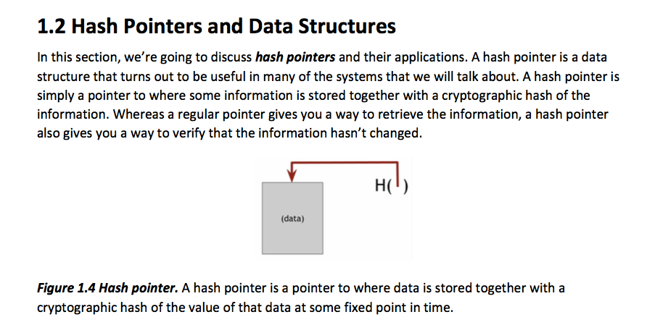
Hash Pointers
< http://bitcoinbook.cs.princeton.edu >

Slide 8
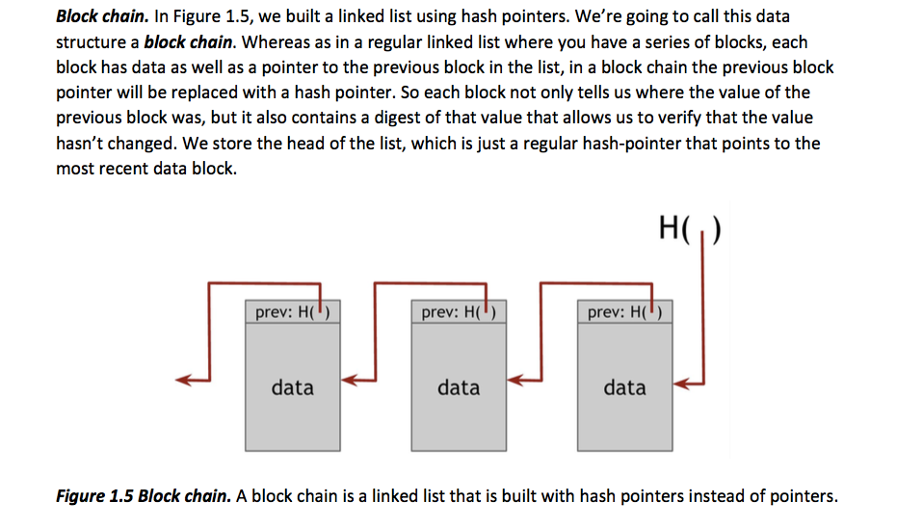
Block Chain
< http://bitcoinbook.cs.princeton.edu >

Slide 9
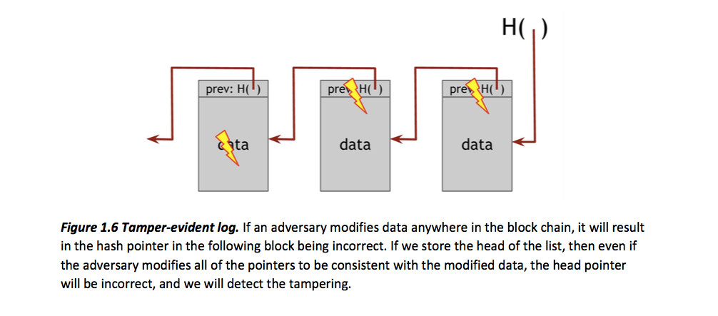
Tamper Evident Log
< http://bitcoinbook.cs.princeton.edu >

Slide 10
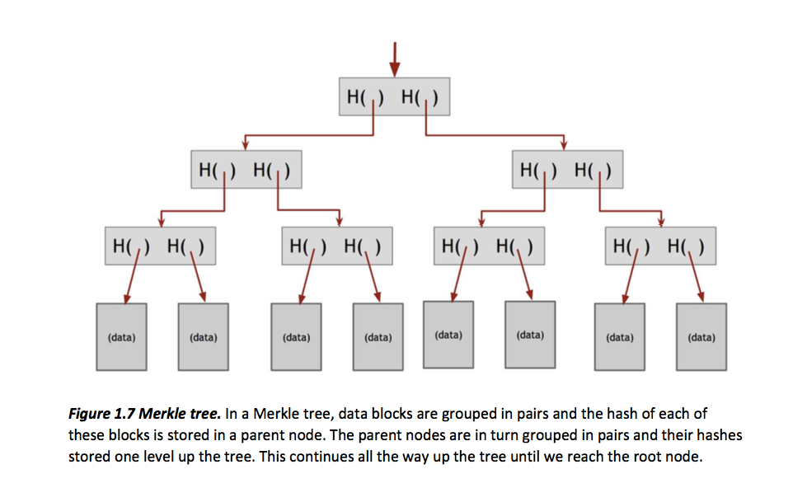
Merkle Trees
< http://bitcoinbook.cs.princeton.edu >

Slide 11
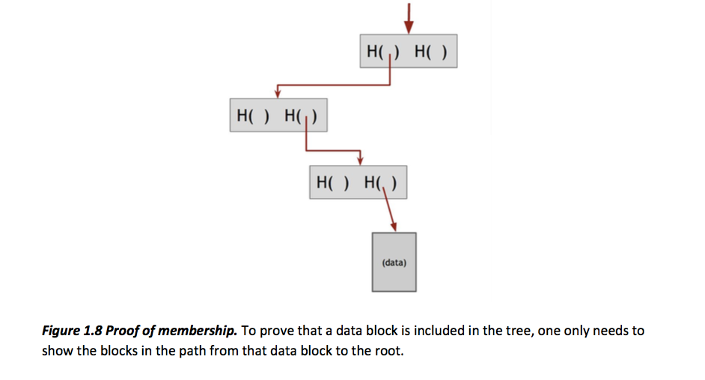
Proof of Membership
< http://bitcoinbook.cs.princeton.edu >

Slide 12
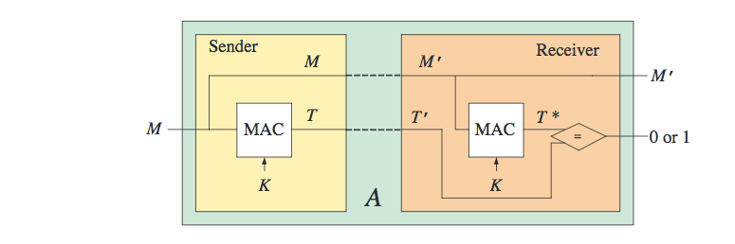
Message Authentication Codes
MAC algorithm standards :
  FIPS PUB 113 Computer Data Authentication (DES based, withdrawn in 2002)
  RFC 2104 & FIPS PUB 198-1 The Keyed-Hash Message Authentication Code (HMAC)
  ISO/IEC 9797-1 Mechanisms using a block cipher
  ISO/IEC 9797-2 Mechanisms using a dedicated hash-function
Message Authentication Codes
  http://cseweb.ucsd.edu/~mihir/cse207/w-mac.pdf

Slide 13
Backup Material

Slide 14
Encryption Attacks
CPA - Chosen Plaintext Attack
An attacker can obtain the ciphertext for any provided plaintext (but does not have the key).
CCA - Chosen Ciphertext Attack
An attacker can also, in addition to being able to perform a CPA, obtain the plaintext for any provided ciphertext (but does not have the key).

Slide 15
Indistinguishability and Non-Malleability
IND - Indistinguishability
The advantage of a reasonable adversary determining what message was sent,
IND-CPA - Indistinguishability under a Chosen Plaintext Attack
IND-CCA - Indistinguishability under a Chosen Ciphertext Attack
INT - Integrity
INT-PTXT - Computationally infeasible to produce a ciphertext decrypting to a message which the sender has never encrypted
INT- CTXT – Computationally infeasible to produce a ciphertext not previously produced by the sender, regardless of whether or not the underlying plaintext is “new”
NM - Non-malleability
Is the advantage of a reasonable adversary being able to change the message to be meaningful
NM-CPA - Non-malleability under a Chosen Plaintext Attack
NM-CCA - Non-malleability under a Chosen Ciphertext Attack
WUF - Weakly unforgeable MAC
An attacker (with the capability of making chosen message attacks) is incapable of creating a new accepted message and tag pair (the message cannot have previously been queried).
SUF - Strongly unforgeable MAC
An attacker (with the capability of making chosen message attacks) is incapable of creating a new accepted message and tag pair (the tag cannot have previously been returned in response to a query - but the message may have been queried).
https://www.cs.jhu.edu/~astubble/dss/notes3c.pdf
http://cseweb.ucsd.edu/~mihir/papers/oem.pdf

Slide 16
Logistics for Class
Canvas CS-486-01
  Primary repository for grading
  URL for all homework submittals must be ‘linked’ into the
  appropriate Canvas assignment!
Github: https://github.com/CryptoUSF
  Course material, class presentations, references, books
  Sample code for assignments: https://github.com/CryptoUSF
  Private student repositories,
    too many if one per assignment per student
  Wiki for additional class information and assignements
Piazza: CS486
  Informal class conversations

Slide 17
Additional References
Courses:
https://crypto.stanford.edu/~dabo/courses/OnlineCrypto/
http://cseweb.ucsd.edu/~mihir/cse207/
Conferences:
Real World Cryptography
https://www.iacr.org
Mailing Lists and Standards:
http://csrc.nist.gov US Federal security specifications
https://trac.ietf.org/trac/sec/wiki Internet security standards
https://irtf.org/cfrg Internet cryptographic research

Slide 18
File Encryption with Classic Ciphers
HW1
Write a Python command-line program to encrypt or decrypt a file.
  The program should:
  - provide command to encrypt or decrypt a file
  - provide option flags to select the algorithm to use for encryption or decryption
  - multiple simple ciphers should be implemented and should include:
  - the Caesar Cipher
  - another simple substitution cipher
  - a poly-alphabetic cipher
  - a transposition cipher
  For every algorithm you implement, please include a description of the algorithm in the docstring and a reference to the source description of the algorithm. References should be wherever possible to historic text for these older algorithms. A list of books are in Canvas for such references.
Example solution code for assignment: https://github.com/CryptoUSF/CS486/blob/master/code/cipher.py
Existing python library reference: pycipher

Slide 19
Cryptanalytic Toolkit
HW2
Write a cryptanalytic toolkit in Python to analyze the statistical properties of files.
  Determine the frequency distribution of characters in an arbitrary string. Print out the Monogram distribution of the characters.
  Determine the Bigram, Trigram or higher distribution of symbols in a file.
Example solution code for assignment: https://github.com/CryptoUSF/CS486/blob/master/code/cipher.py

Slide 20
Prime Numbers
HW3
Review section 4.2 of the “Handbook of Applied Cryptography” [HAC]. Closely read section 4.2.3 (Rabin-Miller)
Complete the ‘is_prime’ routine in:
https://github.com/CryptoUSF/CS486/blob/master/code/prime.py
Your goal is to understand the nature of generating ‘good’ prime numbers. You should understand the implications of the selection of the number of iterations of the Rabin-Miller algorithm. This is a useful routine that you should write to a ‘production grade’. Look at other references and worked code example for the best way to select the number and value of the witness numbers.

Slide 21
Block Ciphers and Hashing
HW4
Write a Python command-line program to:
Encrypt or decrypt a file using a contemporary block cipher
Pick a ‘good’ mode of operation
Consider how to protect the key used for the encryption
Write a Python command-line program to:
Hash a file using at least two contemporary hash algorithms

Slide 22
Cracking Passwords
HW5
Write a Python command-line program to:
Encrypt or decrypt a file using a contemporary block cipher
Pick a ‘good’ mode of operation
Consider how to protect the key used for the encryption
Write a Python command-line program to:
Hash a file using at least two contemporary hash algorithms

Slide 23
Raspberry Pi
We will use a Raspberry Pi to get experience using contemporary analysis ‘tools’
Raspberry Pi
  Excellent reference for what to acquire and how to setup:http://rpi.cs.usfca.edu/2017-fall
  The first Pi project will use cryptographic related tools that are available in the Kali distribution: https://www.kali.org/
  The tools do not necessarily require the Kali OS distribution and you may be able to simply install some of the tools on an existing Raspberry Pi OS installation.

Slide 24
Python References
Python Documentation (Python Web Site)
Code Like a Pythonista: Idiomatic Python (Web site)
Transforming Code into Beautiful, Idiomatic Python (video)
Functional programming in Python
Writing Awesome Command-Line Programs in Python
  Building Command Line Applications with Click
Look at repositories for Python crypto implementations and read the code.

